Slide 1
Introduction to
TTS-Top Talent Solutions
Notes:
----- Meeting Notes (2013/10/21 10:34) -----
Irina
Sahsnee
mankatjee
nonjabulo
Mugsien
Ntswaki
Helen
Lerato
Takalani
Marie

Slide 2


We deliver simple and efficient assessment solutions that help you make better talent decisions and improve talent performance.
contextual | flexible | integrated

Slide 3
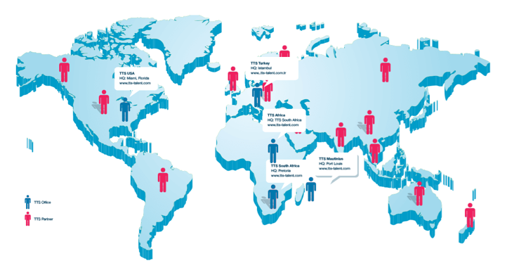
Our global network
Head Quartered in the USA and South Africa, we have significant international experience in the design, implementation and delivery of assessment services.

Slide 4





























Some of our clients

Slide 5
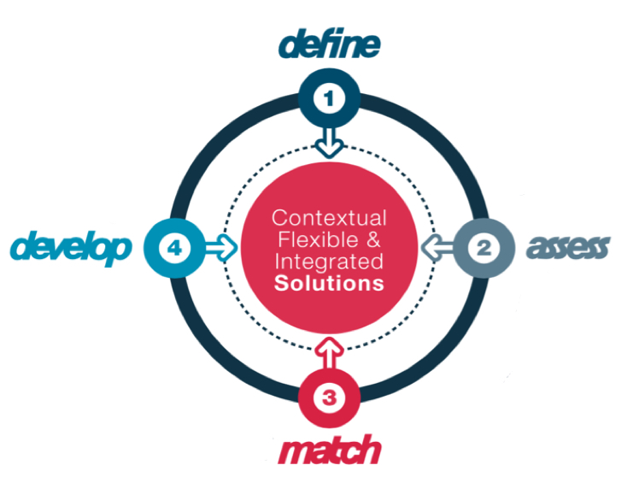
Our approach
You cannot measure what you cannot define.
Specificity and integration in measurement matters.
Actuarial interpretation and report format significantly impact decision quality.
Targeted, blended learning is more effective.

Slide 6
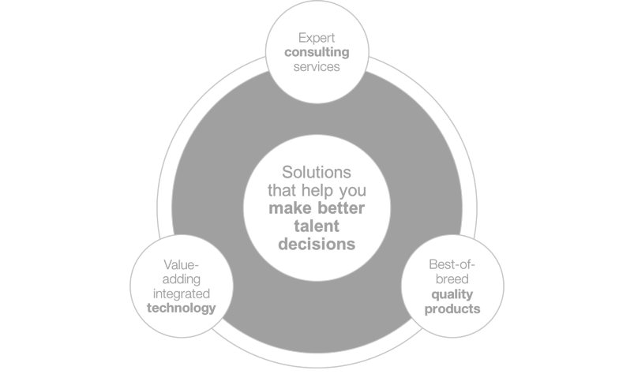
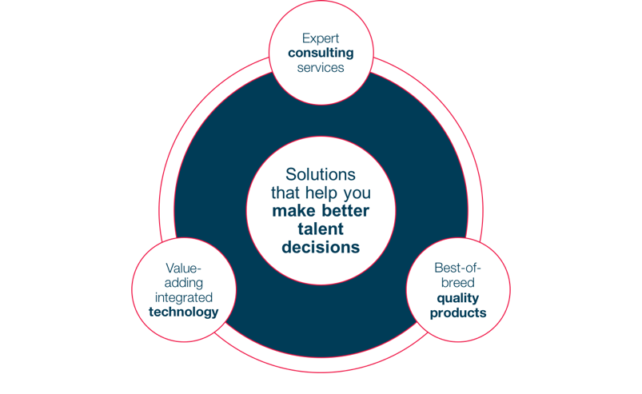
How we deliver
Contextual | Flexible | Integrated

Slide 7
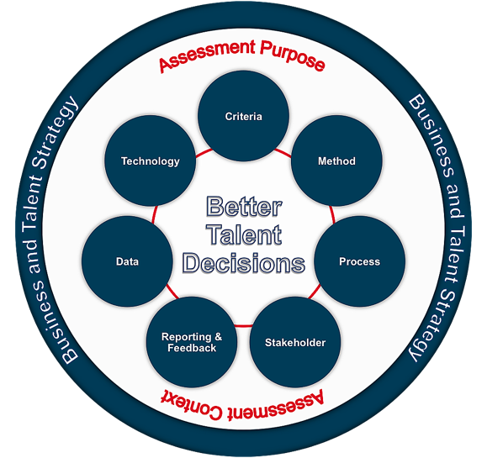
Our consulting approach
The TTS Assessment Practice Maturity Framework©, provides a benchmarked and detailed model that integrates best practice in seven key areas so you get a comprehensive and best practice approach to your assessment needs that is proven to move you up the value curve.

Slide 8
Our delivery team
Our team consist of some of the best qualified and most experienced industrial psychologists in the area of individual assessment.
We specialise in the design, implementation and delivery of integrated online assessments and reporting.
Recent large projects include work in:
  Assessment strategy design
  Leadership framework design
  Development planning
  Graduate selection
  Succession planning
  Executive assessments
  Research and Talent analytics
50 plus years Experience
16 Industrial Psychologists
8 Software Engineers
10 Full-time support staff
26 Delivery Partners

Slide 9
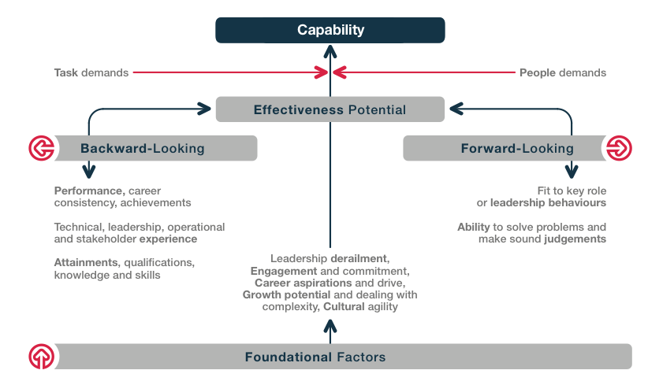
Our product philosophy
The TTS Capability Framework©, describes a holistic approach for individual assessment based on years of validation research and a practical understanding of the factors that leads to performance effectiveness.

Slide 10




Integrated products
Personality Questionnaires
Reasoning tests
Situational Judgement Tests
Values questionnaires
Competency based Interview guides
360-degree questionnaires
Skills tests
Customised assessments

Slide 11














Traditional Assessment Delivery Approach
MULTIPLE
SUPPLIERS & SYSTEMS
MULTIPLE
INVITATIONS
MULTIPLE
LOGINS
MULTIPLE
REPORTS
?
Test Taker
Psychologist or
HR Practitioner
Talent
Decision-makers
Interviews
UN-SAVED OFF-LINE DATA
Complicated logistics
Complex talent decision-making
Increased candidate and user support
Poor governance and supplier management
Limited management information
Poor data management
Inconsistent processes and ‘look and feel’
Limited control over the process
Notes:
Key compo

Slide 12





Delivery with tts-assess
ONE SYSTEM
ONE INVITATION
ONE LOGIN
ONE INTEGRATED
INTELLIGENT REPORT
Test Taker
Psychologist or
HR Practitioner
Talent
Decision-makers
Interviews
ONE DATABASE
WITH OFF-LINE DATA
Improved decision-making
Ease of use
Improved candidate experience
Full access to your data
Complete management reporting
Consistent look and feel
Consistent process
Simplified vendor management
Notes:
Key compo

Slide 13
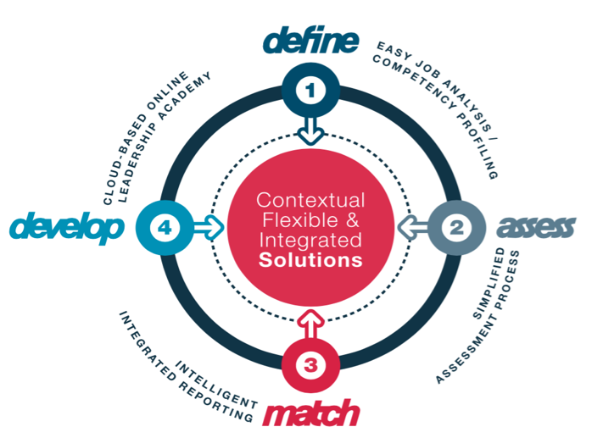
Our technology
290 Clients
16,000 Projects
75,000 Participants
415,000 Instruments
2,600,000 Scores
Cloud based
AWS hosted
Advanced security
Help-desk support
No licenses
62,500 Match Reports

Slide 14
Post assessment value-adding services
TTS provides a full range of research services including:
  Norm studies
  Reliability studies
  Validation studies
  Fairness and EE flow trough analysis
  Questionnaire design
In most cases*, the research services mentioned above are provided free of charge if:
  assessment results are used for research purposes only
  the sample includes at least one product provided by TTS
  data is available in an accessible format
Research areas include:
Area | Measures
Process quality assurance | Consistency of delivery Policy implementation Compliance Procedural fairness Quality of feedback
Instrument research | Norms & benchmarking Reliability & validity research Cost effectiveness Acceptability Practicality
Stakeholder satisfaction | User standards End-user satisfaction Report usability Quality of communication Participant satisfaction
Talent requirements review | Alignment to talent strategy Relevance of competency models and role profiles Measurability
Utility review | Return on Investment Use of information in decision making Changes in selection ratios Total costs
* Questionnaire design excluded.

Slide 15
TTS Assessment service delivery options
TTS provides assessment services to clients using one or a combination of three delivery options. Depending on your needs and assessment strategy, these channels provide a flexible and scalable combination of services based on the same delivery platform, supported by expert consultants and user training.
1
tts-assess Online
Assessment Service
2
Outsourced
Assessments Services
3
Consulting
Projects
Self-sufficient use of tts-assess
Product accreditation training required
System administrator training provided with further TTS support
TTS manage the on-going setup, monitoring and delivery of all aspects of your assessment service
Training required for HR business partners in the use of reports
TTS designs and delivers an end-to-end assessment service for talent management projects
No further training required

Slide 16




Our pricing models
Our pricing models allow you to choose between ad-hoc ‘low commitment’ or longer-term fixed subscription options. Our assessment costs are not based on your choice of delivery channel, but on the type of partnership you would like to have with us. This provides you with the flexibility to choose the delivery options and pricing models independently, and allows us to give you the support you need without having to discuss significant additional ‘bureau’ charges.
Pay-
as-you-go
Fixed Pre-paid volume
Flexible Pre-paid volume
In-contract
For clients that requires a fairly standard assessment service
Smaller ad hoc assessment projects
Invoiced as the service is used with 30-day payment terms
For clients that would like to make a more long-term commitment
Requires the payment of an initial once-off ‘In-contract’ initiation fee
Get an immediate 33% discount on all product costs*
Invoiced as the service is used with 30-day payment terms
Available to in-contract clients only
Pre-payment for larger volumes of between 100 to 5000+ assessments
Qualify for additional discounts of between 5% and 40%**
Pre-paid volumes remains in credit and expire after 12 months
Includes free research services***
Available to in-contract clients only
Contracted based on estimated annual volume of assessments
Fixed quarterly, 6 monthly or annual payment terms
Credit expires at the end of the term.
Pricing based on specific assessment batteries and reports
Includes free research services***
*Value added products like Hogan, CPP, CPA, etc. are excluded
** Dependant on product partner volume discount options
*** Some conditions may apply

Slide 17
How we deliver

Slide 18
Pre-Assessment

Slide 19



Pre-assessment define and design
Jobs and
success profiles
Select assessment methods and batteries
Report format
design

Slide 20
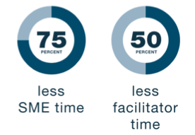

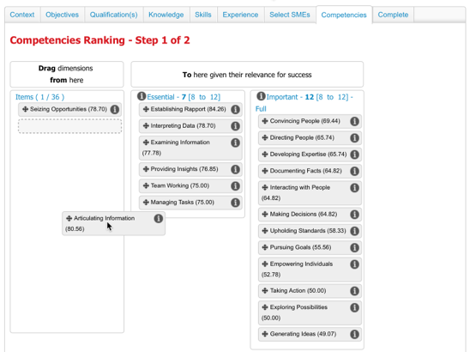
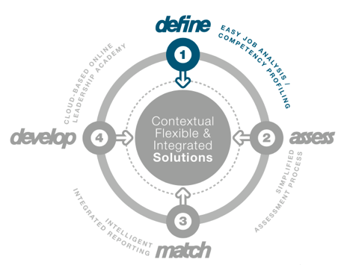
Easily define what good looks like
  Use any competency, behavioural or skills model.
  Own the process and the content.
  Build and brand your own job analysis wizard.
  Integrate multiple geographically dispersed perspectives.
  Assign specific tasks to specific users.
  Utilise ranking and ratings.
  Open-ended input or validation of job relevant information.

Slide 21
ESSENTIAL LEADERSHIP BEHAVIOURS (TOP 7)
Core behaviours (Wave dimensions), identified as part of job analysis, required for success in all leadership roles.
Establishing Rapport
Convincing People
Making Decisions
Directing People
Empowering Individuals
Managing Tasks
Taking Action
IMPORTANT LEADERSHIP BEHAVIOURS (PER LEVEL)
GRADE 14 - 15
GRADE 12 - 13
GRADE 12 -13
GRADE 12 - 13
GRADE 10 - 11
SENIOR MANAGERS
MANAGERS
MNGR CUSTOMER
MNGR SALES
SUPERVISORS
Examining Information
Examining Information
Interpreting Data
Interacting with People
Examining Information
Developing Expertise
Interpreting Data
Interacting with People
Articulating Information
Documenting Facts
Generating Ideas
Adopting Practical Approaches
Articulating Information
Conveying Self-Confidence
Interpreting Data
Articulating Information
Providing Insights
Conveying Self-Confidence
Showing Composure
Adopting Practical Approaches
Challenging Ideas
Articulating Information
Showing Composure
Embracing Change
Providing Insights
Showing Composure
Conveying Self-Confidence
Embracing Change
Inviting Feedback
Articulating Information
Embracing Change
Showing Composure
Team Working
Team Working
Showing Composure
Upholding Standards
Embracing Change
Meeting Timescales
Upholding Standards
Embracing Change
Seizing Opportunities
Team Working
Upholding Standards
Seizing Opportunities
Team Working
Meeting Timescales
Meeting Timescales
Upholding Standards
Checking Things
Upholding Standards

Slide 22



Pre-assessment implementation
Decision models and Assessment strategies
System and
service setup
User
Training

Slide 23


Best Practice and Accreditation Training
To empower your Practitioners, HR Business Partners, Line Managers and system users, we provide a range of product accreditation and best-practice training courses. Where appropriate, course content can be tailored to your specific needs.
Product accreditation training for:
  Saville Consulting
  Success Profiling
Line/HR Business Partner training
  Overview introduction of the available tests
  Introduction to competency frameworks
  Introduction of the assessment service
  Reports and application
  Governance, policy and pricing - roles and responsibilities
Best practice training in:
  Job analysis and competency design
  Situational Judgement Test design
  Competency based Interviewing
System training in the use of our technology platform

Slide 24
Assessment Delivery

Slide 25




Assessment delivery
Project
setup
Test takers booking and registration
Test
administration
Observers and Assessors

Slide 26
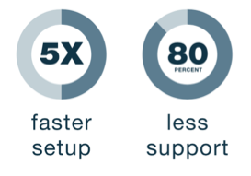
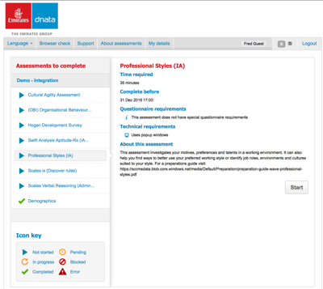
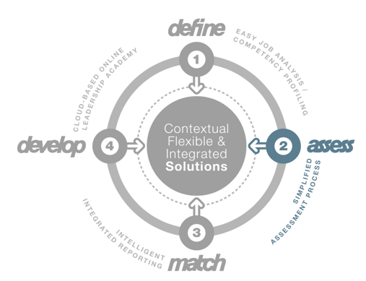

Cloud-based delivery of assessments
One Login
One database
One relationship
One invoice
One report
Multiple options

Slide 27
Example batteries: Management
Managerial / HI-Po / Leadership Roles
Saville Professional Styles (Expert Report)
Hogan Development Survey (HDS - Data Report)
EQ derived from Wave Professional Styles
Saville Swift Analysis Aptitude
Organisational Behaviours Index (OBI) Dependability
Senior Sales Roles
Saville Professional Styles (Sales Report)
Hogan Development Survey (HDS - Data Report)
Organisational Behaviours Index (OBI) Dependability
Saville Swift Analysis Aptitude
Development Programmes
Saville Professional Styles (Expert Report)
Hogan Development Survey (HDS - Data Report)
EQ derived from Wave Professional Styles
Swift Analysis Aptitude
Organisational Behaviours Index (OBI) Dependability
Hogan Motives, Values, Preferences Inventory (MVPI - Data Report)
EQ derived from Wave Professional Styles with Expert Report
Career Pathing Appreciation
Hogan Motives, Values, Preferences Inventory (MVPI - Data Report)
Career Pathing Appreciation
Career Pathing Appreciation
OPTIONAL
Costs exclude VAT and any implementation costs or pre-paid volume discount

Slide 28
Example batteries: Junior Management and Talent Succession Toolkit
Managerial / HI-Po / Leadership Roles
Saville Work Strengths
cut-e Abilities (verbal and numerical reasoning; logical thinking)
cut-e Views (Interests and Motives Questionnaire)
Emotional Maturity derived from Work Strengths
Other Sales Roles
Saville Commercial Strengths
cut-e Abilities (verbal and numerical reasoning; logical thinking; multi-tasking; short-term memory)
Technical / Apprentices
Saville Work Strengths
cut-e Abilities (verbal and numerical reasoning; logical thinking; mechanical-technical understanding; spatial reasoning)
Customer/Call Centre
Saville Customer Strengths
cut-e Abilities (verbal and numerical reasoning; logical thinking; multi-tasking; short-term memory; concentration)
Organisational Behaviours Index (OBI) Dependability
Organisational Behaviours Index (OBI) Dependability
Organisational Behaviours Index (OBI) Dependability
Organisational Behaviours Index (OBI) Dependability
OPTIONAL
Costs exclude VAT and any implementation costs or pre-paid volume discount

Slide 29
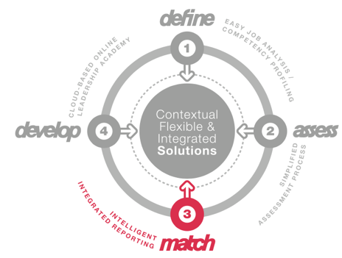
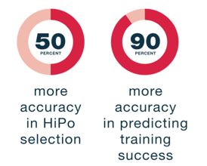
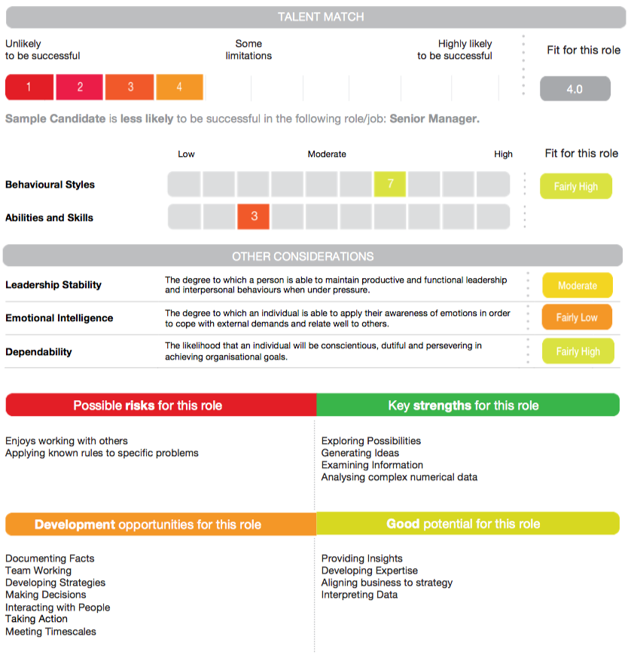
Intelligent Talent Match Reports
  Fully integrated
  Aligned to your competencies
  Available immediately
  Customisable
  Recommendations based on consistent, validated logic
  Integrate off-line information
  Include Competency based interview guide and Personal development tips.

Slide 30

Talent Match Report contents
 | Comparative Merit List and group report | TMR Line Manager report | TMR Development report | TMR Selection report with summary | Fully integrated report
Overall Talent-Match score
Detailed competency scores
Fit against company models
Summary strength & development areas
Selection interview questions
Personal development tips
Application form information
Consultant written narrative summary and recommendation
All reports are customisable and fully branded

Slide 31
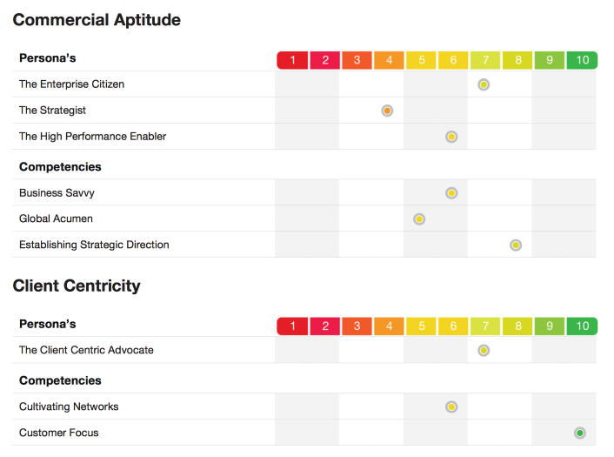
Example of report using composite values based on mapping to company competencies

Slide 32
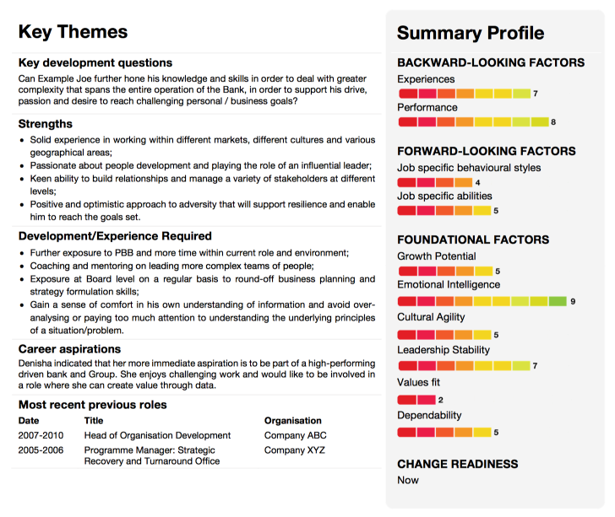
Example of a integrated succession report

Slide 33
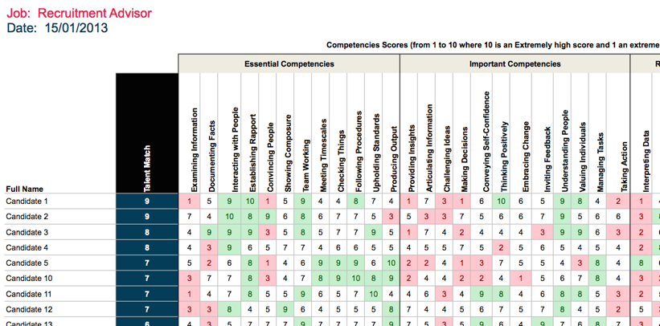
Example Merit List
Rank order and compare candidates in large volume projects

Slide 34
Post-Assessment

Slide 35




Post-assessment reporting
Report
generation
Individual and Management Feedback
Management information
HRMS
integration

Slide 36
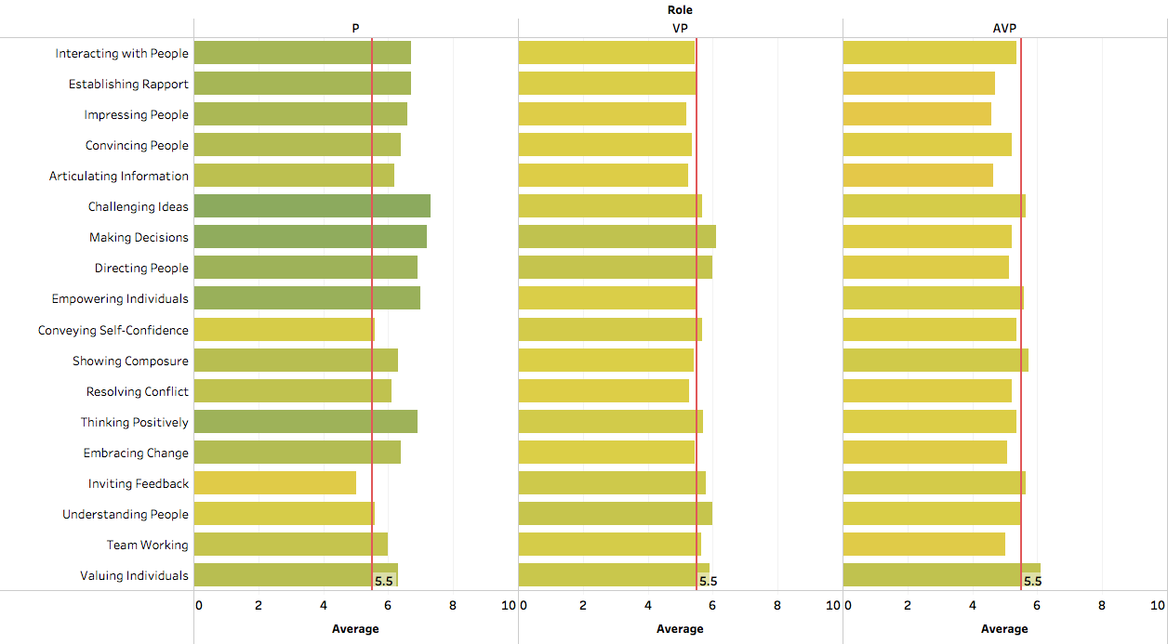
People related competencies: Principals, VP and AVP
Strengths in the People related competencies supports a more ‘action orientated’ leadership style.
The Principal group shows strong positive, change orientated leadership potential, but can be more open to feedback.
The VP and AVP group scores are generally more average. This could be a function of the larger sample size, however, one would expect a more elevated profile in certain areas given the nature of the group and the purpose for the assessment (talent validation).
Possible development areas are indicated with a D where applicable.
D
D
D
D
D
D
D
D
D

Slide 37
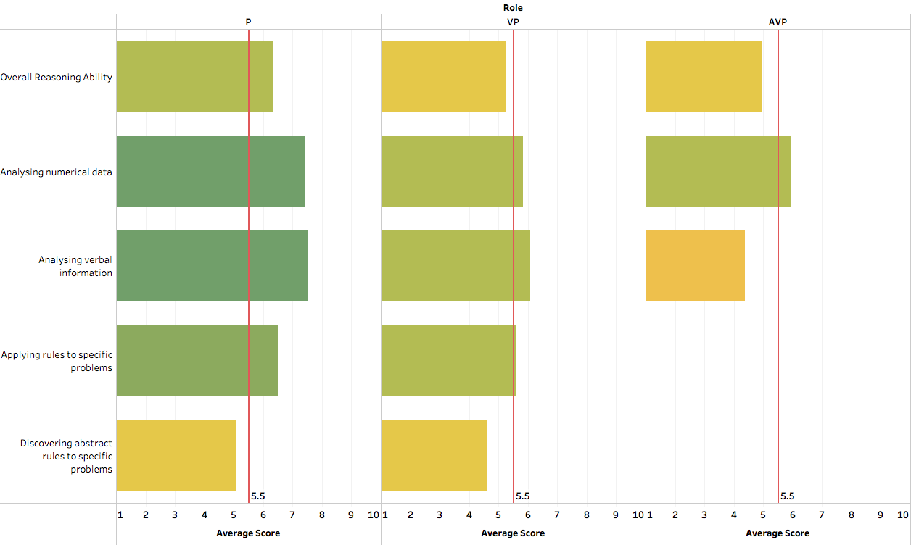
Distribution of reasoning assessment scores
Scores of the VP and AVP groups are
generally below average in comparison to
the benchmark group.
Scores in these areas are much lower than expected for a senior group and suggests
a lack of potential to deal with complex abstract inductive
reasoning (such as required for more conceptual
strategic development)

Slide 38
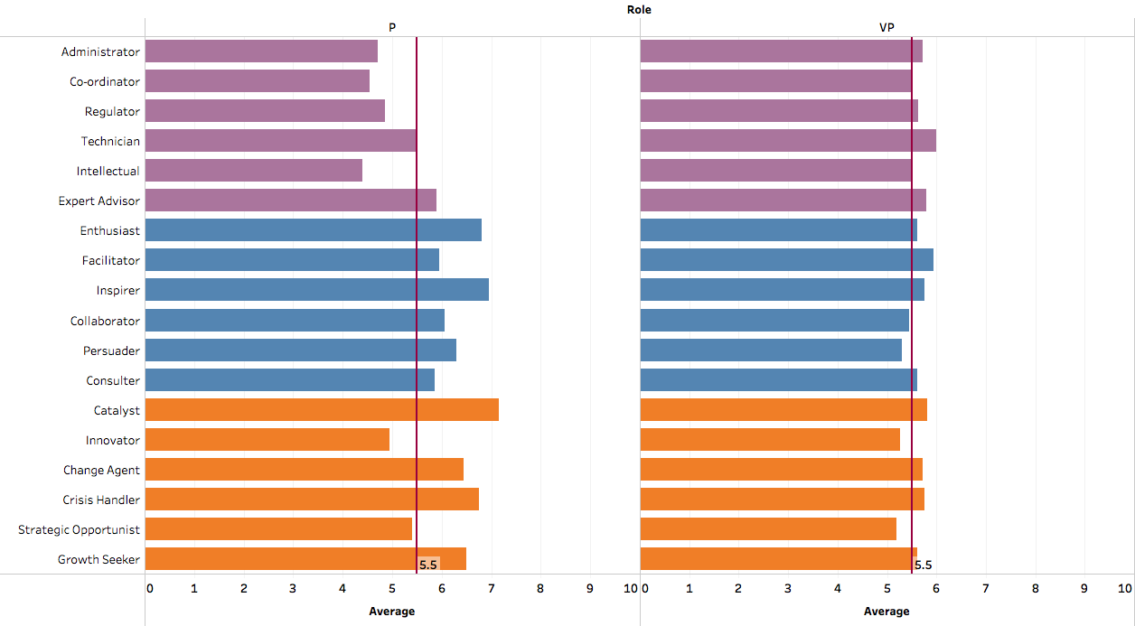
Leadership Impacts: Principals and VP’s
Potential for People and Pioneering impact areas are generally stronger for the Principal group.
Enthusiasts engage others by building rapport and taking an optimistic approach.
Inspirers lead by motivating others while asserting themselves in the leadership role.
Possible areas of concern can include the lack of ‘Intellectual’, ‘Innovator’ and ‘Strategic Opportunist’ roles.
Intellectuals lead by developing understanding and capability within their team.
Innovators foster a creative and conceptual environment where original thought is valued.
Strategic Opportunists combine competitiveness with strategic awareness.
Development areas in these areas are potentially exacerbated by lower abstract inductive reasoning test scores.
The extent to which the lack of potential for certain impact areas is concerning, is dependent on the strategy of the organisation.
Service and
Product Delivery
Lower scores in these roles are generally expected for Executives in less technical areas
Managed Risk
PROFESSIONAL
Expert Reputation
Organisational
Commitment
Successful Teams
PEOPLE
Communication
New Products
and Markets
Organisational
Transformation
PIONEERING
Organisational
Growth

Slide 39
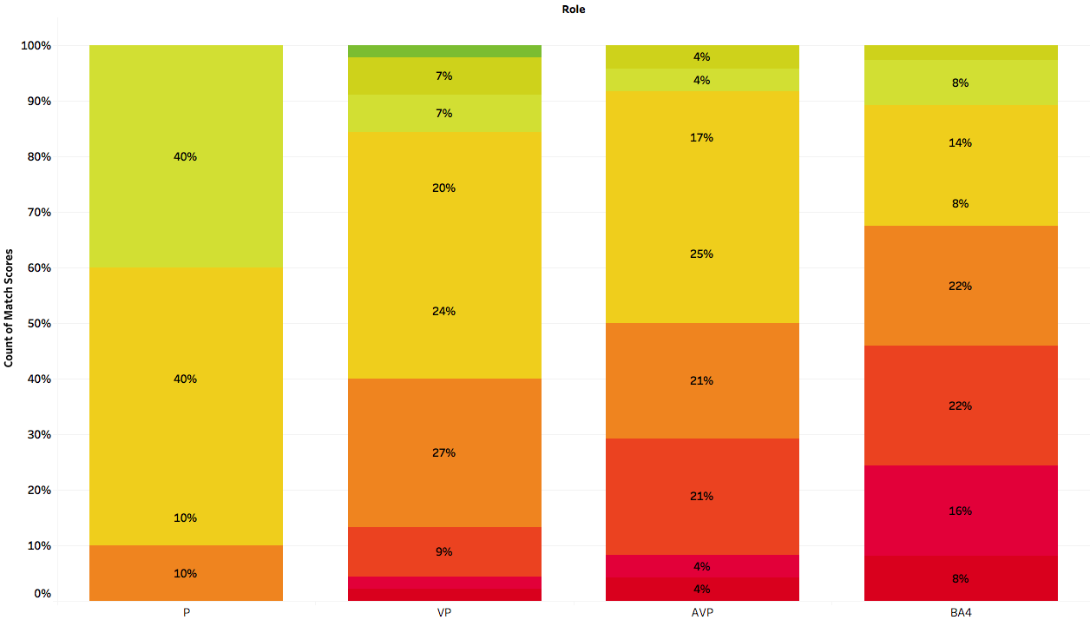
Distribution of Talent Match Fit scores
The Talent Match Score indicates the fit of an individual with the ideal requirements as identified for a particular role.
Fit scores are generally poorer toward the lower end of the leadership pipeline (BA4).
This does suggest weaker bench strength and a possible lack of future capability for more senior roles.
Given that the individuals in the sample have been nominated as talent, the result may also suggest a miss-alignment between manager perceptions and the criteria for what good looks like.

Slide 40
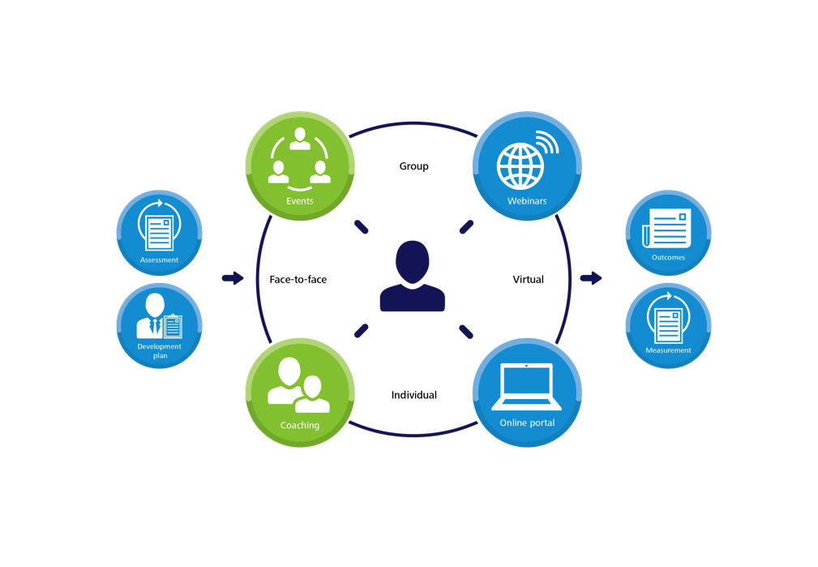
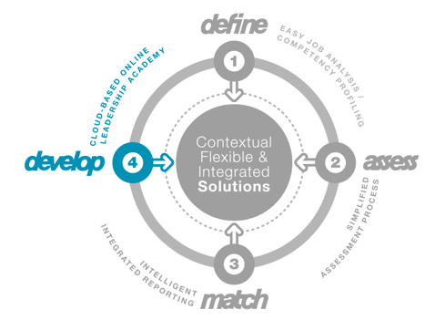
Further Development options
The TTS online Leadership Academy provides additional development options as part of a blended learning approach.
Individual reports with development tips
CoachMatching
tts-develop online leadership academy

Slide 41
Thank you

