Slide 1
This report:
Interpretation Guide
May be used in feedback
Talent Match Overview Report Useful for:
May not be shared with the individual
May be shared with management
Does not require expert interpretation
Selection
Succession
Requires a Success Profile
Contains confidential information
Notes:
----- Meeting Notes (2013/10/21 10:34) -----
Irina
Sahsnee
mankatjee
nonjabulo
Mugsien
Ntswaki
Helen
Lerato
Takalani
Marie

Slide 2
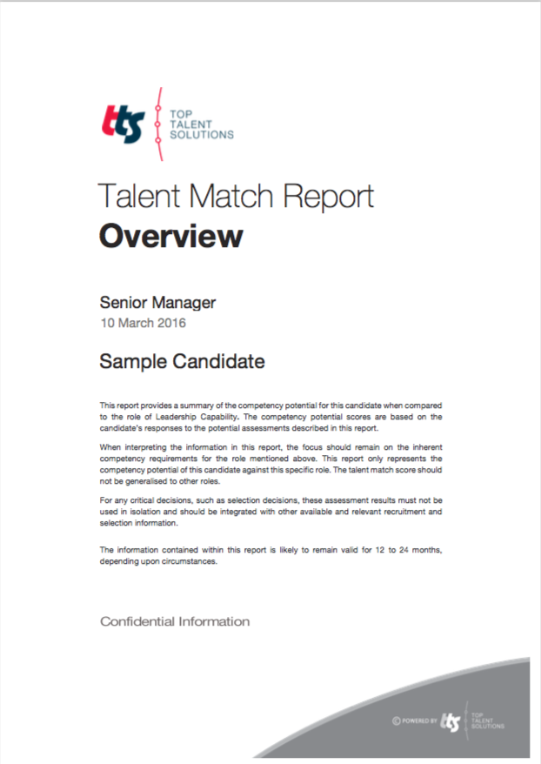
How to use this guide and report
The aim of this document is to provide guidance in the use of the Talent Match overview Report. The report is generated using assessment results from various assessment tools.
This guide contains more information on:
The contents of the report
How to use the rating scales
How to interpret the fit score, profiles and summary grid
Type of report
Name of success profile used for matching
Report generation date
Candidate name
This report contains confidential personal information.
Always take additional information into account when making selection decisions.
Key to symbols used in this guide:
Take note
Be careful
Warning

Slide 3
What may be included in this report
Talent Match Score | The Talent Match score is a calculated, weighted score based on the individual’s profile matched against the ideal success profile for a particular role. It provides an indication of probability of success.
Report sections
Behavioural fit summary A summary grid indicating the areas of likely risk, development opportunities, good potential and key strengths of an individual as compared against the success profile of a role.
Detailed weighted profile An overall behavioural profile based on the Wave performance culture framework.
Fit to job specific profile The behavioural profile is weighted against the ideal success factors for the role to provide a ‘Fit to job specific competency profile’.
Additional considerations that may include: Thinking factors Growth potential and capability to deal with complexity given thinking styles and reasoning ability.
Emotional factors An indication of factors that may impact leadership stability and emotional intelligence.
Motivational factors Likely fit to the values (including integrity) that are important to the organisation.
The overall recommendation will change if the individual is matched to another success profile. Don’t compare individuals that are matched against different profiles.
Depending on the assessment battery, some of these sections might not be available for a particular individual.

Slide 4
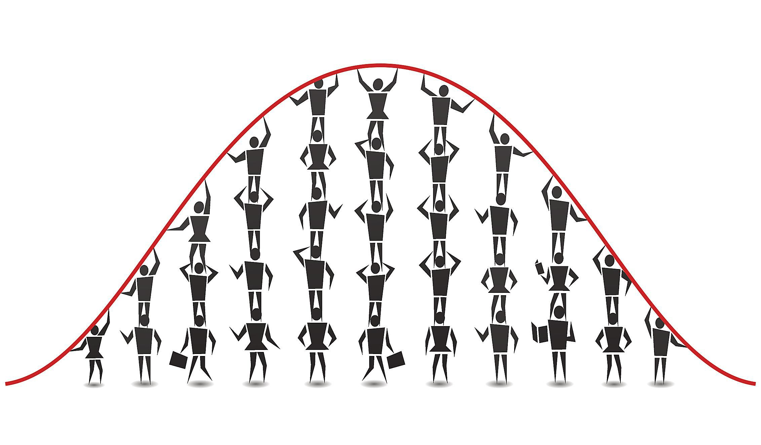
More about the scores used in this report
The individual profile scores from the assessments have been compared with other individuals who have previously completed these assessments.
Results are shown on a scale of 1 to 10.
In this example, a score of 4 indicates that this individual performed better than only about 25% of the group they were compared to. In comparison to other people, this is a fairly low score and development may be required.
In contrast, a score of 7 indicates that the individual performed better than about 75% of the group. This is a fairly high score and a possible strength for this individual.
Remember that scores of 5 and 6 are average and typical for most people.
Significant development required
Development required
Effective
Strength
Significant
strength
*Percentage better than comparison group

Slide 5
Interpreting the Talent Match Score
The fit score is dependent on an accurate success profile. Always confirm the accuracy of the success profile before making talent decisions.
Don’t use success profiles that are not based on proper job analysis.
The overall recommendation is a calculated, weighted score based on the individual’s fit against the essential and important behaviours, as well as the essential skills and capabilities for this role. It provides an indication of probability of success.
The results are based on a 1 to 10 scale where 1 is unlikely to be successful and 10 is highly likely to be successful.
In this example, a score of 4 indicates that this individual’s fit against what is required for this particular role is fairly low and he/she is less likely to be successful in this role.
This score will change if the individual is matched to another success profile. Don’t compare individuals who are matched against different profiles.
Remember that a score of 5 and 6 is average and, although, typical for most people, does indicate some areas of poor fit that needs consideration.
Always take additional information into account when making selection decisions.
Individuals with fit scores less than 4 are typically very unlikely to be successful.

Slide 6
Interpreting the sub-scores
The report provides additional summary profiles for thinking, emotional and motivational factors. Each area my contain multiple dimensions and sub-scores.
Overall score for the dimension on a 10 point scale
Section
Implication of overall score
The rest of the report provides a detailed profile for each of these sections.
Scores in these areas are included in the overall recommendation.

Slide 7
Interpreting the other considerations section
The report provides additional summary profiles for thinking, emotional and motivational factors. Each area may contain multiple dimensions and sub-scores.
Short generic description of the dimension.
Section
Dimension
Implication of score
If the CPA or CPP was used as part of the assessment battery the C indicates the current level and P the potential level. Where applicable, the green bar indicates the ideal range.
The rest of the report provides a detailed profile for each of the summary profiles.
Scores in these areas are typically seen as additional information for consideration and not included in the overall recommendation.
In some reports the short generic description is replaced by a bar graph.

Slide 8
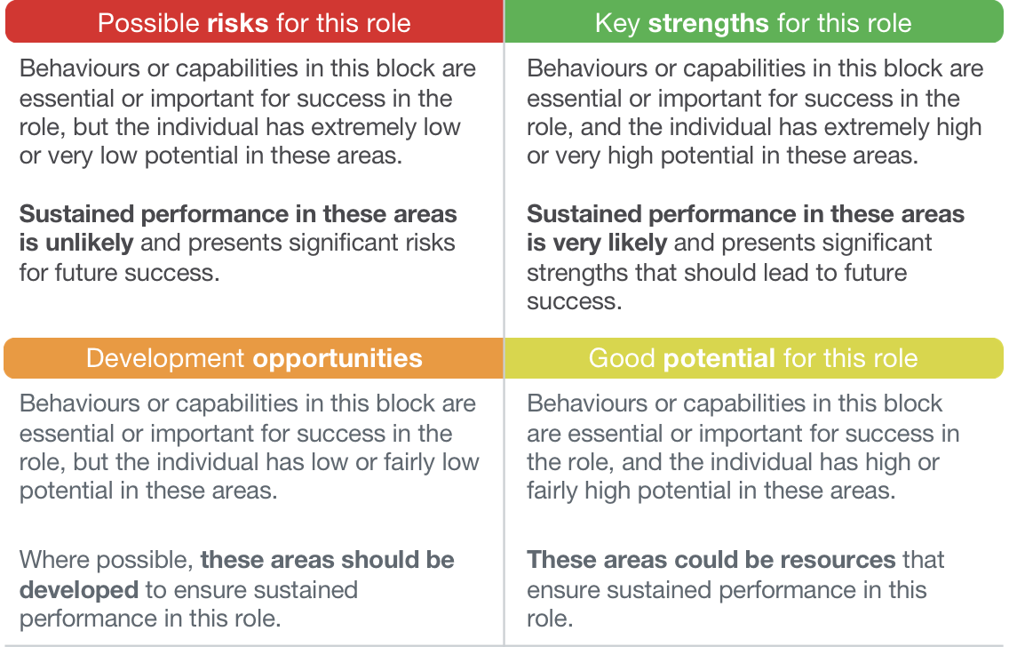
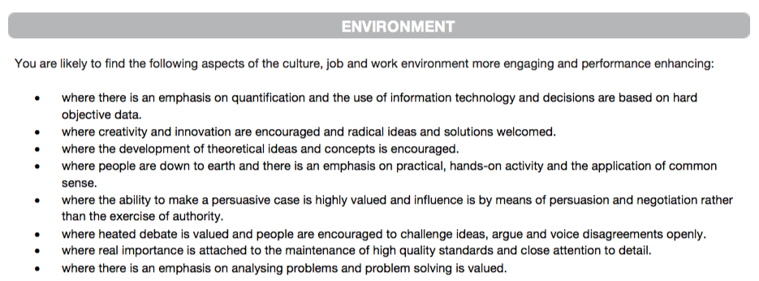
Interpreting the Summary grid
This section will highlight the most significant behaviours and capabilities that are seen as areas of strengths to leverage, good potential, primary development opportunities as well as possible risks for the role.
It will also provide more information on the type of workplace or environment that will enhance the chances of success.
The grid only reports on behavioural areas. Do take additional information provided in the rest of the report into consideration before making any final decision.
This summary is based on the highest and lowest scores from the completed behavioural styles questionnaire.
It is recommended that you initially look at both the personal strengths and development areas as part of the development strategy.
In some cases there might be no strengths or developmental behaviours identified. In cases like these, identify the behaviours that would be to the greatest benefit for development in the current work context.

Slide 9
Interpreting the detailed profile
The report provides detailed scores for dimensions that have been selected as essential and important for a particular role. These are indicated as ’Essential’ and ‘Important’ behaviours.
In this example, the individual has fairly high scores on three dimensions that are essential for job success, making them a better fit for the role.
In particular he/she is:
very likely to make quick decisions, take responsibility and have definite views on issues; and
comfortable with change and enjoys new challenges.
But, he/she is also less likely to:
enjoy working with facts and numerical data; and
may not always adopt a practical approach in problem solving.
These scores does suggest that the individual might not always follow a very factual or practical approach when making quick decisions.
Weight
Dimensions
Overall score for the dimension on a 10 point scale
Always link dimensions together to make sense of the full profile. Never use a single score to make a final talent decision.
Remember to always keep the requirements of the role in mind when considering the implications of scores.

Slide 10
Interpreting the essential skills and aptitudes scores
This section of the report provides detailed scores for the skills, ability or aptitude tests. These abilities are almost always seen as essential for future job performance.
In this example, the individual has a very low or well below average score for working with diagrammatic information. However, he/she has a typical (or average) score when working with words and numbers.
These scores suggest that he/she is much less likely than most to reach conclusions by applying general rules to existing problems. This skill is important for competencies like insightful problem solving and systematic thinking.
In contracts, he/she should find it as easy as most to examine complex written information, document facts, make insightful presentations or accurate deductions from verbal written or spoken material. This skill is important for competencies like solving business problems; written communication and making presentations.
Weight
Dimensions
Overall score for the dimension on a 10 point scale
Always link dimensions together to make sense of the full profile. Never use a single score to make a final talent decision.
The score is determined by the individual’s performance, the difficulty of the test and the benchmark group used. Never compare scores using different tests or benchmark groups.

Slide 11
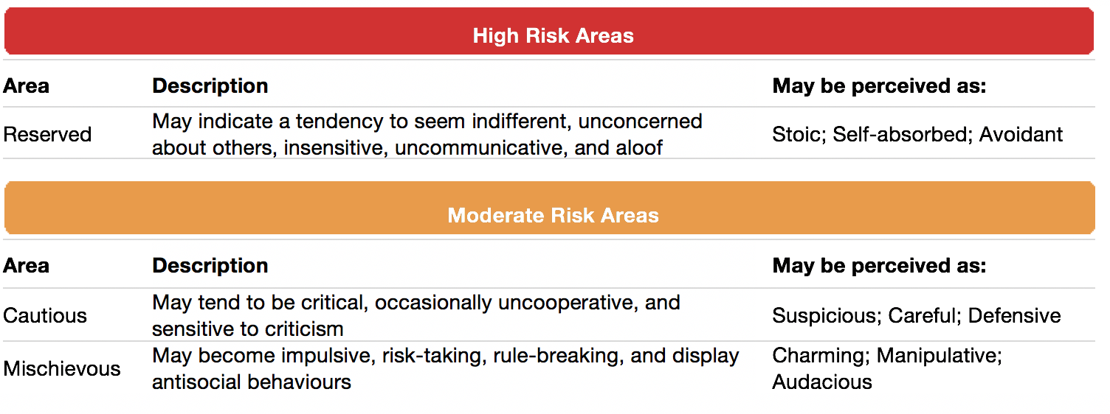
Interpreting the leadership stability profile
In some cases, the report provides an overview of scores for the dimensions related to certain leadership challenges or possible over-played strengths. These are patterns of interpersonal behaviour that tend to appear when a person is overly tired, stressed, or bored. These behavioural patterns are not typical of leaders, but could negatively affect leadership style .
Scores are grouped into two bands: High and Moderate risk areas.
Keep in mind that all people have risks in one or more of these areas. Leadership stability is only a risk if the individual has three or more high risk areas.
In this example, the individual is likely to become reserved or unconcerned about others when stressed. Others may therefore experience them as overly self-absorbed and uncommunicative.
Keep in mind that all people have risks in one or more of these areas. Leadership stability is only a risk if the individual has three or more high risk areas.
Risk areas are only likely if the person is overly tired, stressed, or bored. The likelihood of derailment is therefore linked to the individual’s capability to deal with stress or level of resilience.

Slide 12
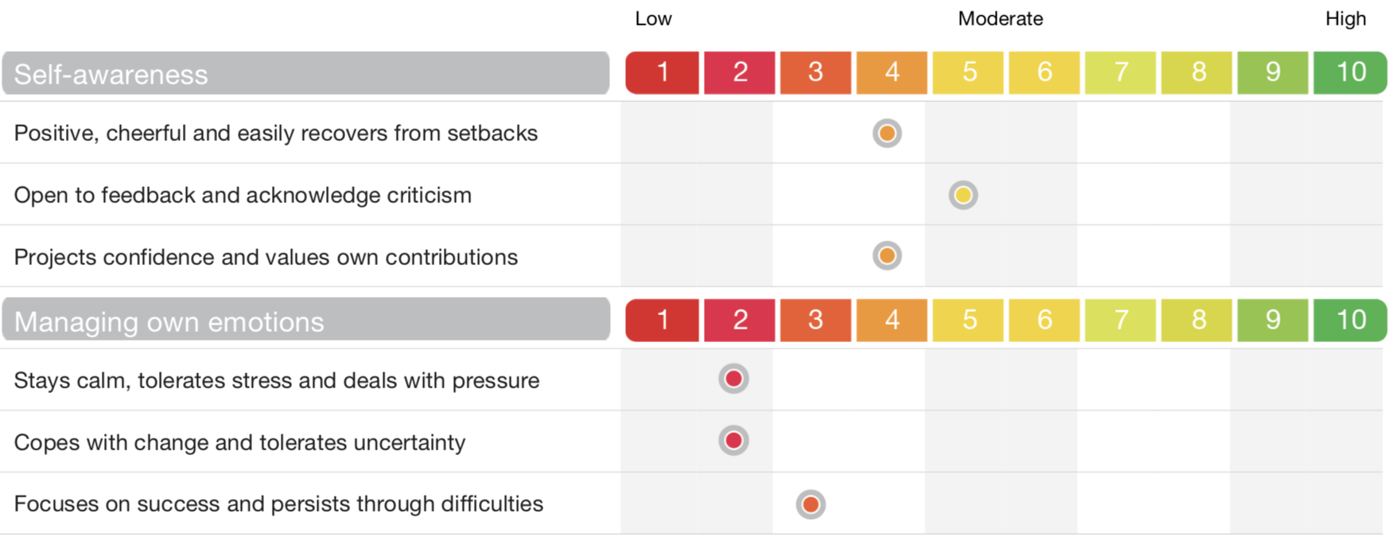
Interpreting the Emotional Intelligence profile
In some cases, the report provides an overview of scores for the sections and dimensions related to Emotional Intelligence. More emotionally intelligent people are generally better at displaying behaviour that allows them to effectively deal with change. The profile provides an indication of potential for emotional intelligence.
Elements of emotional intelligence
Score on a 10 point scale
Dimension descriptors
Try to link themes from the overall behavioural profile to scores in this profile.
Keep in mind that emotional intelligence is often context dependent. Explore the context and don’t over-interpret scores.

Slide 13
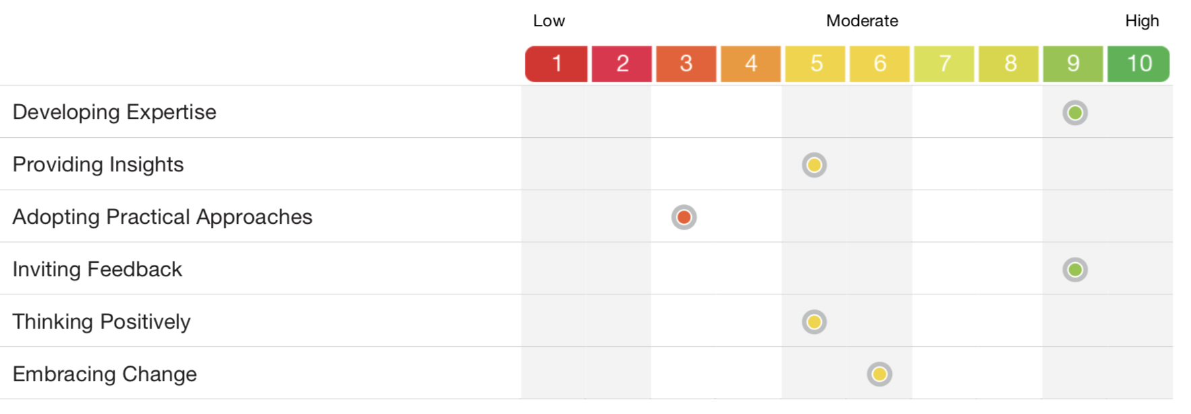
Interpreting the Growth Potential profile
The degree to which an individual is likely to improve critical skills and knowledge over time and thus display potential for growth and development in the organisational context. The profile provides more information on the various factors that may impact the capability of an individual to grow, learn and develop into the future. This capability is affected by an openness to learn (growth orientation) and reasoning ability or aptitude.
Growth Orientation relates to the individual’s willingness and openness to learning. Individuals with higher scores are more likely to seek and accept new learning opportunities, grasp things quickly, invite feedback about their own performance and approach new challenges positively
Behavioural preferences
Scores in this area relates to the individual’s capability to learn or work with information in different forms. Individuals with higher scores are more likely to find it easy to quickly work with information and learn faster.
Reasoning ability

Slide 14
Interpreting the dependability risk profile
More dependable people tend to be better team workers, score better on customer service measures, deliver work of a better quality, and are less likely to be involved in risky behaviours related to fraud, absenteeism, team conflict and safety incidents.
In this example, the individual has a fairly high dependability score indicating a fairly low level of risk.
In particular he/she is:
very likely to be trustworthy and reliable and therefore likely to meet commitments and may be trusted to complete work that meets standards, however,
has a fairly low score on the likelihood to engage in pro-social or organisational citizenship behaviours.
These scores do suggest that the individual might be very reliable, but is unlikely to ‘go the extra mile’ or feel guilty when others have to work harder than themselves.
Overall dependability risk score
Dependability sub-scores
Only consider scores of 2 and lower as significant risk. Even in these cases, always consider the detailed dimensions and include additional information.
Always link dimensions together to make sense of the full profile. Never use a single score to make a final talent decision.
Remember to always keep the requirements of the role in mind when considering the implications of scores.

Slide 15
FOR MORE INFORMATION
For more information or questions on the use of this report, please contact advisory@tts-talent.com

